Slide 1


ALTSCHOOL OF Cybersecurity (BARAKA 2025)
Week 4

Slide 2
REFRESHER – WK 3 DAY2
Risk Assessment
Risk Assessment & Analysis
Risk Mitigation (Control Implementation)
Risk Monitoring & Detection
Incident Response & Recovery
Labs: Deployed VM an AWS and Created Sophos Central Account

Slide 3
Week 4 – DAY 1
Overview Legal Frameworks
  Introduction to key Legislation and Regulations (GDPR, HIPAA, CCPA, etc.)
    Importance of Data Protection and Privacy Laws
    The growing need for compliance in a digital world
    Understanding Data Privacy & Security Regulation
  Compliance Requirements and Standards
  Intellectual Property and Copyright Laws
DEFENSE IN DEPTH
  LEAST PRIVILEDGE
  SEPERATION/SEGREGATION OF DUTIES
  SECURITY THROUGH OBSCRUITY
  FAIL SAFE DEFAULTS
  LABS: SOPHOS CENTRAL

Slide 4
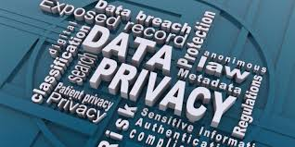
Introduction to key Legislation and Regulations
Importance of Data Protection and Privacy Laws - Data protection and privacy laws are essential in today’s digital world, where vast amounts of personal and sensitive information are collected, stored, and processed by organizations. These laws help safeguard individuals' rights, ensure businesses handle data responsibly, and protect against cyber threats and data misuse.

Slide 5
Introduction to key Legislation and Regulations
The growing need for compliance in a digital world -
In today’s fast-evolving digital landscape, the need for organizations to comply with data protection and privacy regulations has become more critical than ever. The rapid expansion of digital technologies, cloud computing, and global connectivity has resulted in an unprecedented volume of data being created, shared, and stored. This transformation presents significant risks, making regulatory compliance essential to safeguard sensitive information and ensure business continuity.

Slide 6
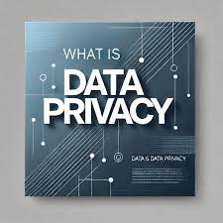
Introduction to key Legislation and Regulations
Understanding Data Privacy & Security Regulation- Data protection and privacy laws are legal frameworks designed to regulate how personal and sensitive information is collected, processed, stored, shared, and secured by organizations. These laws aim to protect individuals’ rights to privacy while ensuring that businesses handle data responsibly and securely.

Slide 7
Introduction to key Legislation and Regulations
Data Protection Laws
Data protection laws govern the security and management o personal data to prevent unauthorized access, misuse, or breaches. They establish guidelines for:
How organizations collect and store data
Who can access the data
How data should be transferred and protected
The security measures required to prevent breaches

Slide 8
Introduction to key Legislation and Regulations
Data Privacy Laws
Data privacy laws focus on ensuring that individuals have control over their personal information. These laws define:
The rights of individuals over their data (e.g., access, deletion, rectification)
The obligations of organizations in obtaining consent and being transparent
How data can or cannot be shared with third parties

Slide 9
Introduction to key Legislation and Regulations
Understanding Data Privacy & Security Regulation- Data protection and privacy laws are legal frameworks designed to regulate how personal and sensitive information is collected, processed, stored, shared, and secured by organizations. These laws aim to protect individuals’ rights to privacy while ensuring that businesses handle data responsibly and securely.

